Slide 1
Invitation
to the UNESCO City of Media Arts

Slide 2
Arrive and feel revived
Smart UNESCO City of Media Arts
Under the Top 10 in the European Smart City Ranking
Changeable European Capitel of Culture 2009
Capital of Upper Austria in a conurbation with around 780.000 people
Approx. 90% of the Austrian population lives within a radius of only 250 km
Notes:
Video link

Slide 3
Why Linz?
Linz is successful
Close networking between research, creatives, service providers and industry.
Culture for everyone
Affordable variety with 16 stages, 12 museums, and Europes‘ most modern music theatre in Europe.
A focus on quality of life!
Danube city with 50% green area, boat trips, Danube Cycle Path, Donausteig Hiking Trail.
Experience Innovation at the voestalpine Stahlwelt
Opera, Operetta, Musical and Dance at the Musiktheater
Enjoy a walk with a view at Pöstlingberg

Slide 4
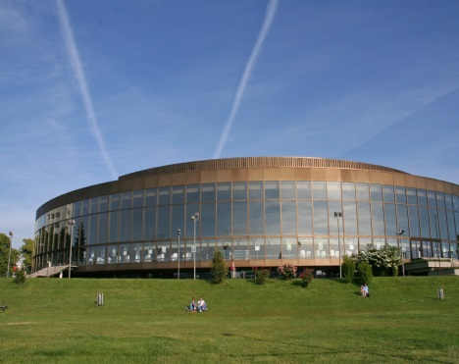
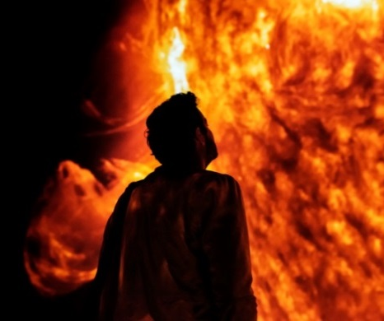
Exciting. Choices
Music at Brucknerhaus with views to the Danube park
Spectacular mixture of light and art at the Lentos Kunstmuseum
Discover something new at a tour around Mural Harbour
Play video
Jump into the future at the Ars Electronica Center
The largest universal museum at one place: Schlossmuseum Linz
Stunning ways of presenting art at the OÖ Kulturquartier

Slide 5
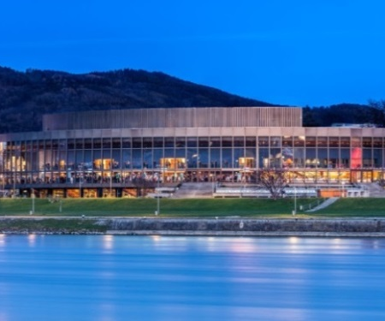
Anton Bruckner 1824 –1896
The composer lived in and around Linz and influences the region until today.
The Brucknerhaus connects music at an international level with unique views at the banks of the river Danube.
The worldwide respected Bruckner-Orchestra looks back on a history of 200 years. It can be experienced in Linz on a regular basis.
Anton Bruckner changed the course of music at the pipe organs of Linz and St. Florian.

Slide 6
At the heart of Europe
Train Linz <> Vienna
1:15 h
Linz lies in an ideal location and can be reached quickly by car, train or plane.
Flight connections from/to Linz:
The „blue danube airport“connects Europe and the world with the UNESCO City of Media Arts.
Direct rail connections to Linz, among others from:
Salzburg Central Station in 1:10 h Munich Central Station in 2:45 h

Slide 7
LINZ
VERÄNDERT
Discover Linz and get off the beaten track

